Slide 1
Spanning Tree Protocol
Njegovan Milović
Notes:
Spanning tree is Layer 2 protocol defined with 802.1D IEEE standard.

Slide 2
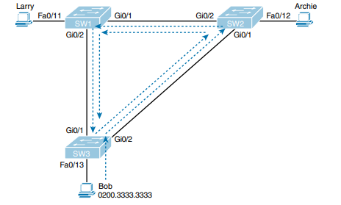
The Need for Spanning Tree
Network Redundancy
Three concerns:
Broadcast storms
MAC table instability
Multiple frame transmission
Notes:
Redundancy - Just one looping frame causes what is called a broadcast storm. Broadcast storms happen when any kind of Ethernet frames—broadcast frames, multicast frames, or unknown-destination unicast frames—loop around a LAN indefinitely. Broadcast storms can saturate all the links with copies of that one single frame, crowding out good frames, as well as significantly impacting end-user device performance by making the PCs process too many broadcast frames.

Slide 3
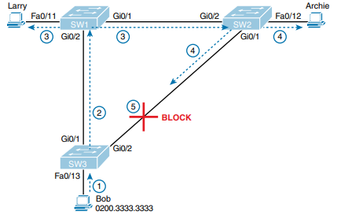
What Spanning Tree Does
STP prevents loops by placing each switch port in either a forwarding state or a blocking state.
Notes:
It means it will create a single path to each point in the network

Slide 4
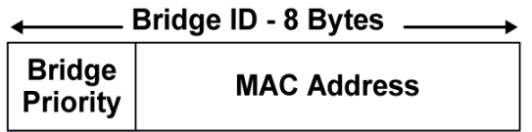
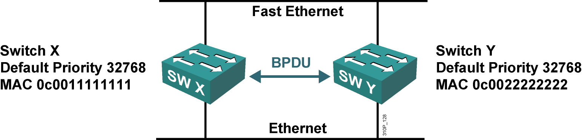
Root Bridge Election
BPDU
Bridge ID
Notes:
To advertise themselves to another switches and learn about other switches…
What are these BPDUs are used for? To better understand this election process, you need to understand the STP/RSTP messages sent between switches as well as the concept and format of the identifier used to uniquely identify each switch.
It is an 8 byte field which is divided into two parts. The first part is a 2-byte Bridge Priority field (which can be configured) while the second part is the 6-byte MAC address of the switch. While the Bridge Priority is configurable, the MAC address is unique amongst all switches and the sum of these two ensures a unique Bridge ID.

Slide 5
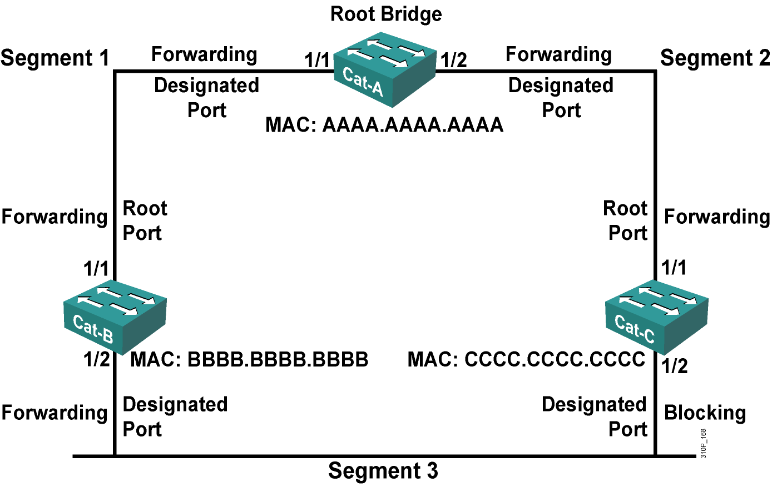
How Spanning Tree Works
STP uses three criteria to choose whether to put an interface in forwarding state:
One root bridge
per network
One root port
per non root bridge
One designated
port per segment
All other interfaces are placed
in blocking state

Slide 6
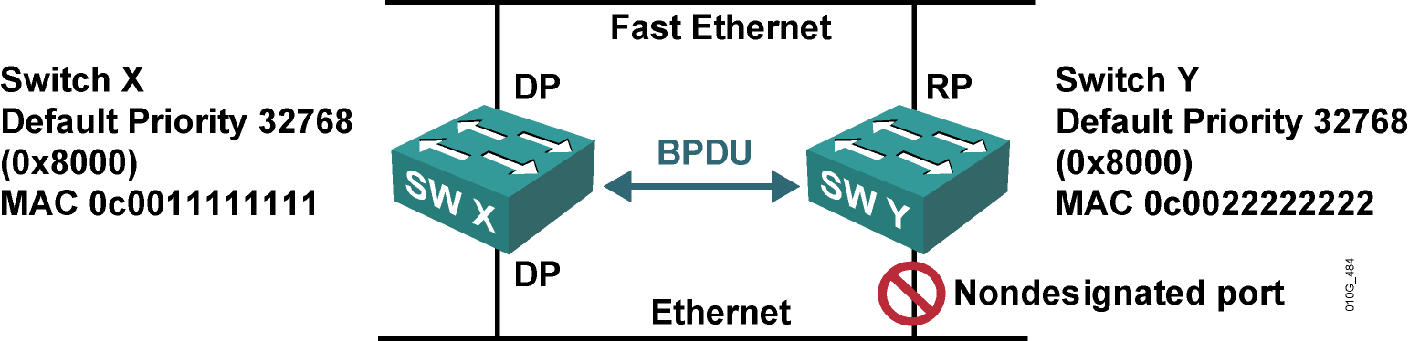
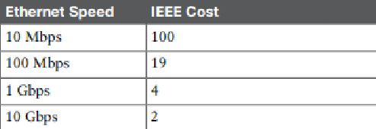
Root Port Selection
SW X is the root bridge.
SW Y needs to elect a root port.
Which port is the root port on SW Y?
Fast Ethernet total cost = 0 + 19.
Ethernet total cost = 0 + 100.

Slide 7
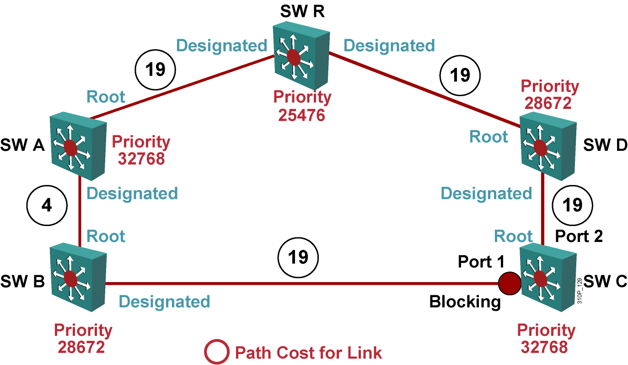
Example: Topology Negotiation

Slide 8
Example: Topology Negotiation

Slide 9
Spanning Tree Timers
Hello timer: 2 seconds.
Maximum Age (Max Age): 20 seconds.
Forward Delay (Fwd Delay): 15 seconds.

Slide 10
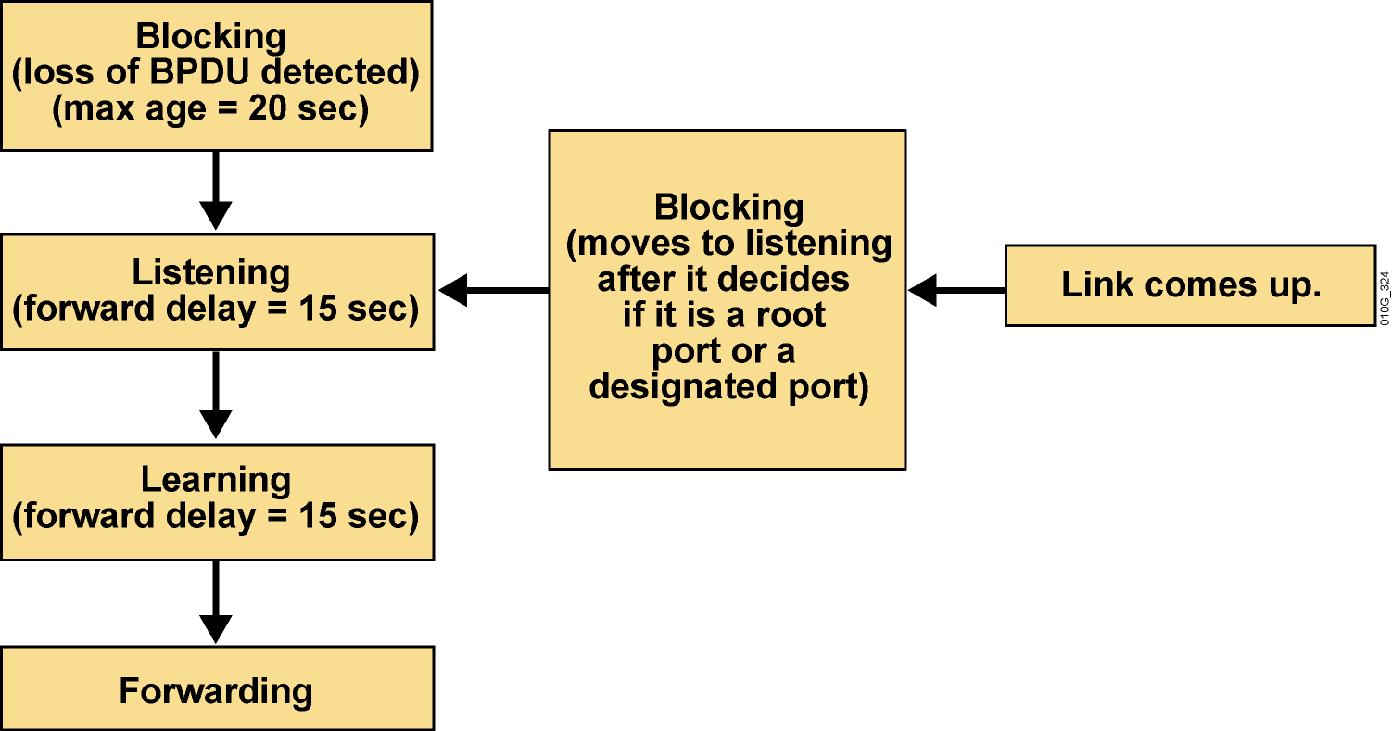
Spanning Tree Port States

Slide 11
Summary
STP is defined with IEEE 801.1D standard
Per VLAN STP
Rapid Spanning Tree Protocol (IEEE 801.2W)

Slide 12
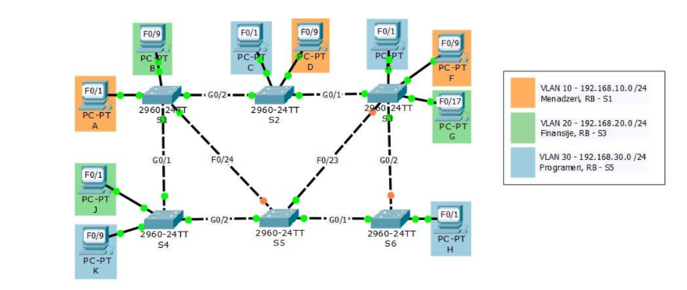
Zadatak

Slide 13
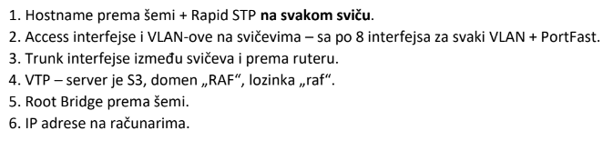
Zadatak

